Slide 1
Semı-automatıc segmentatıon and annotatıon of vıdeos usıng alıgnment wıth audıo subtıtles
BERKE ESMER CEMAL AYTEKİN

Slide 2
Project outlıne
The project contains the following features,
Speech Recognition
Use of body pose detection software
Clustering in time
GUI design for annotation

Slide 3
Week one

Slide 4
Agenda
Openpose framework
Demo examples, Key point JSON output
Python scripts – Frame Generator & Subtitle Parser
Google CoLab, Docker images
Manual dataset creation
Tensorflow, Keras
Github

Slide 5
Community-based work
Google CoLab
Docker

Slide 6
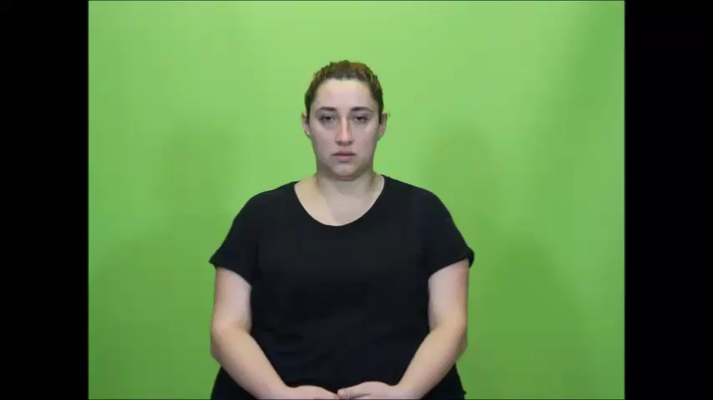

Slide 7
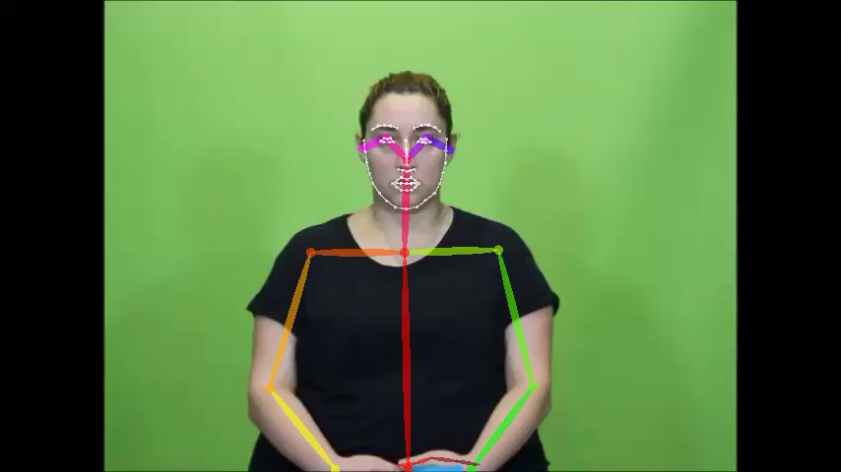

Slide 8
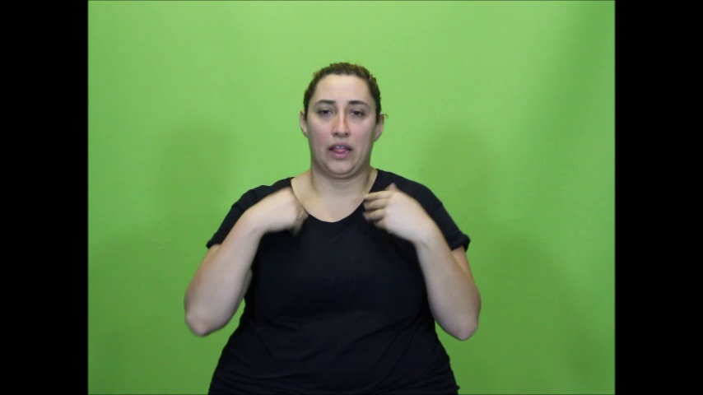
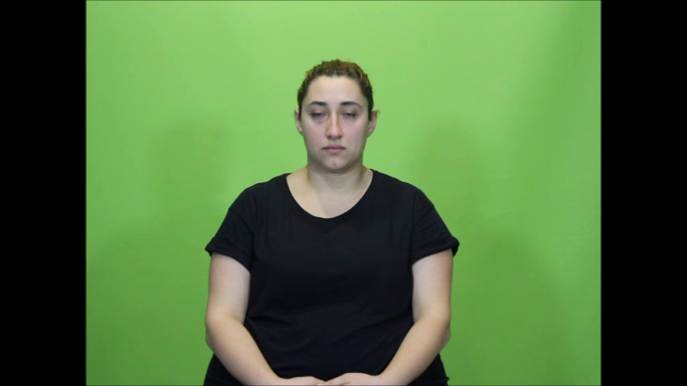

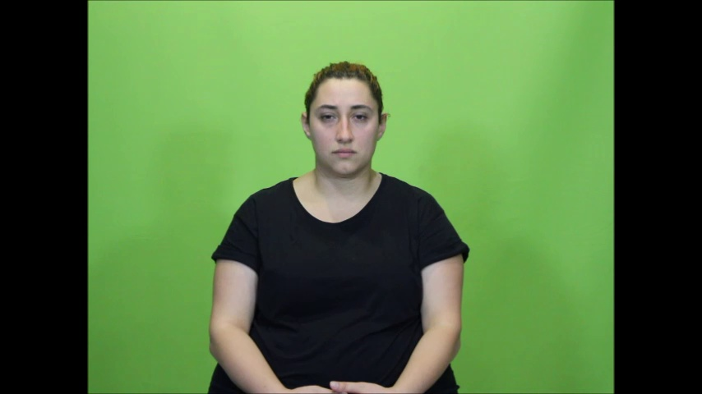
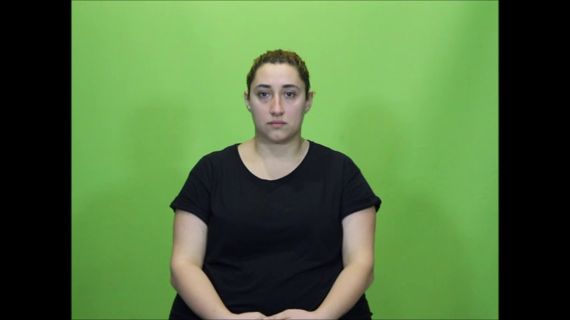
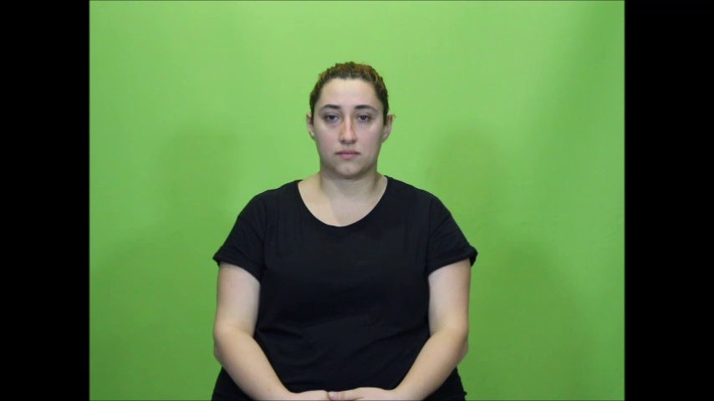
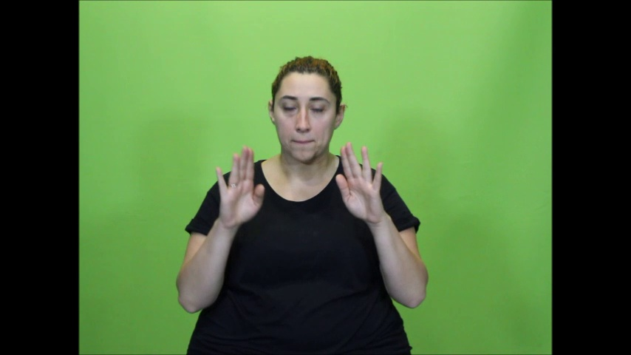
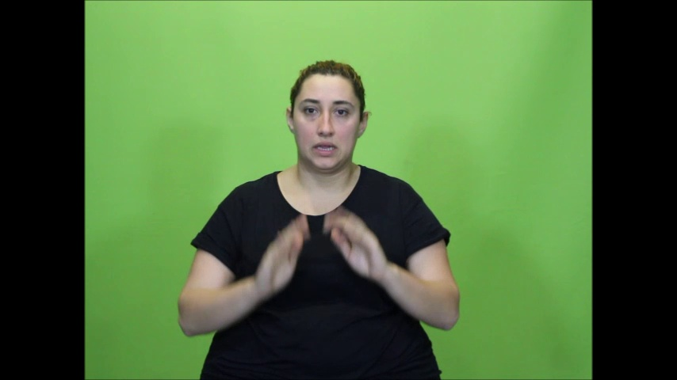

Slide 9
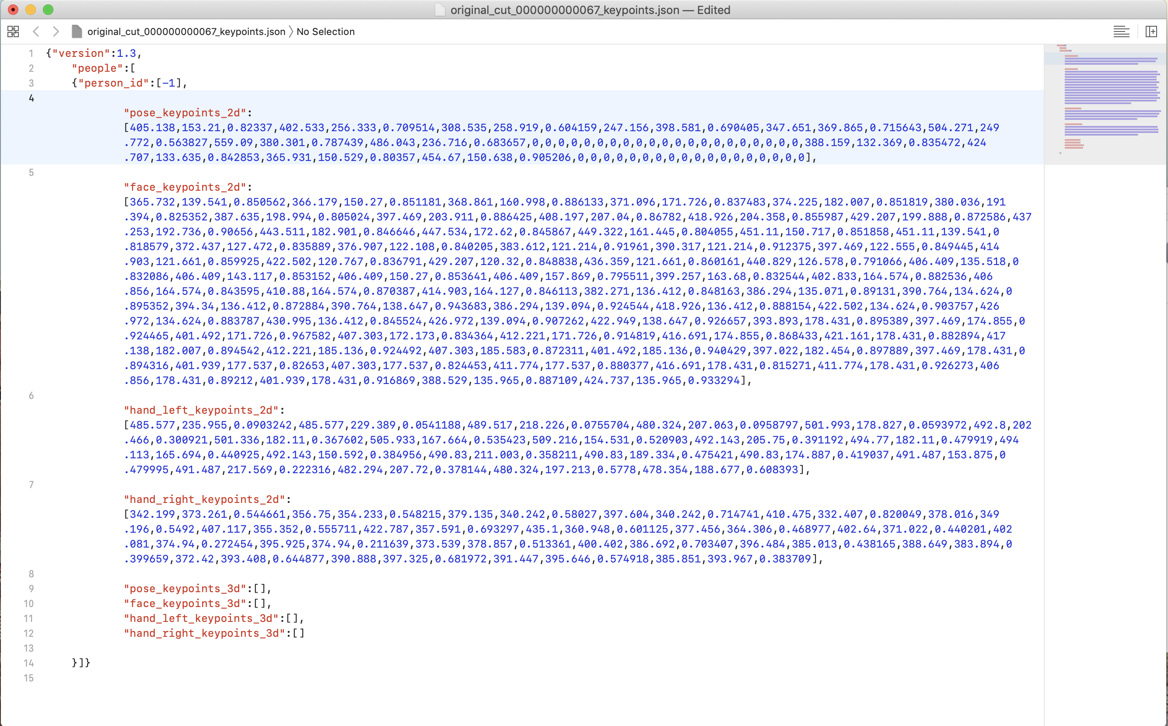
Notes:
Manual dataset, up and down libraries

Slide 10
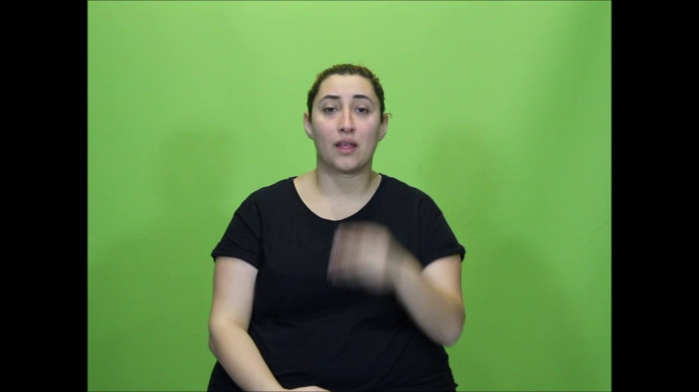

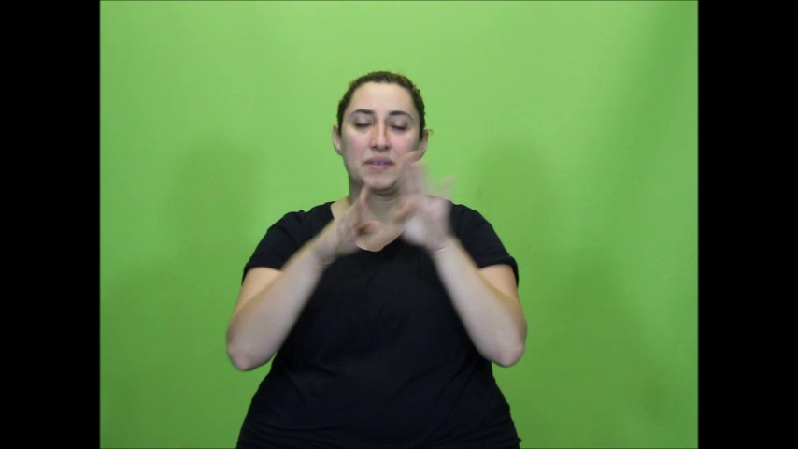

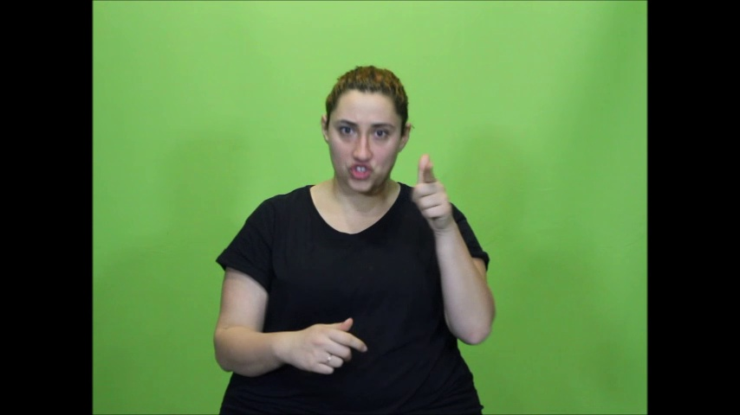
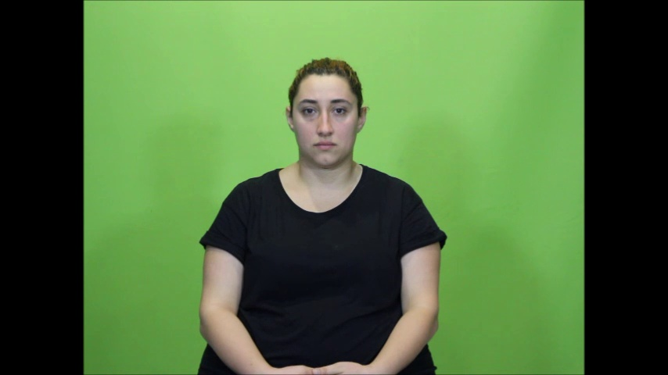
Hands up
Hands DOWN

Slide 11
Next week
Frame motion blur reduction
Key point JSON interpretation
Video segmentation

